Slide 1
Useful Suggestions for Bachelor and Master Theses as well as Written Projects and Term Papers
Area Corporate Development
(Last Update: April 2024)

Slide 2
General Remarks
Technical terminology should be used, technical terms have to be defined with first use
Precise expression is best achieved through simple (short) and clear sentences
The "I" or "we" form is not common in German scientific texts (only permitted for English texts)
No use of “one", i.e. do not use “one knows that" etc.
Use gender-neutral language or both gender forms
Formal deficiencies have a (negative) influence on the grade
More helpful information about writing a scientific text can be found here: https://www.springer.com/gp/authors-editors/authorandreviewertutorials/writinginenglish/overview/10252642

Slide 3
Table of Contents
Based on the structure of a scientific journal article
Contains the list of all headings of the theses
In exactly the same wording as in the text of the theses
With indication of the corresponding page numbers
Front page and table of contents are not included, however, abbreviations, tables and illustrations, bibliography and appendix with corresponding page references have to be included

Slide 4
Other Lists
List of abbreveations: contains only formulations that are not generally used (see for example Oxford dictionary). Only abbreviations used in the paper have to be listed.
List of figures and tables: Only if at least one figure/table is included, the number, heading and page number have to be mentioned.
A foreword is not part of a theses, a term paper or project work.

Slide 5
APA Citation
The APA citation style has to be used in your thesis
The APA style is based on an author-date system, with a shortened reference to the source in the text and the complete source reference included in the bibliography. Footnotes with references are therefore not required.
Useful links on the APA style:
"Guidelines for citation according to APA-Style (6th)" of the University of Zurich: https://www.business.uzh.ch/dam/jcr:e8b8dd18-7dc7-4750-9196-b28349a48d8a/Richtlinien%20zum%20Zitieren_Thesis.pdf
Short manual: https://www.smu.ca/webfiles/APAInText2020.pdf
https://apastyle.apa.org

Slide 6
Quoting – „DOs and DON‘Ts“
DOs
Use of scientific articles from (international) journals.
Little use of literal quotations (e.g., to define a term).
DON‘Ts
The use of monographs should be avoided if possible.
Internet sources should be avoided if possible.
Plagiarism (intellectual theft, that is the adoption of other people's thoughts without corresponding proof of source) is prohibited (results in a grading of "not sufficient"!)

Slide 7
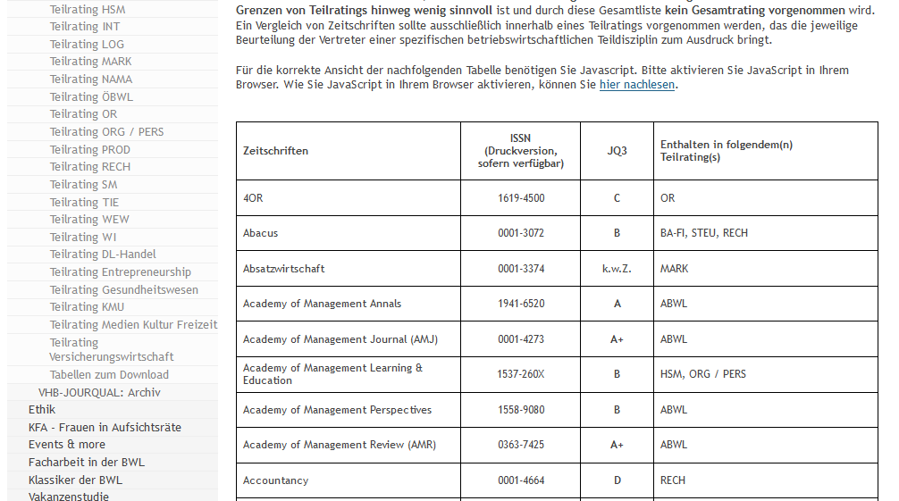
Quality of scientific studies
We recommend citing studies solely from top journals (VHB-JOURQUAL A, B, (C)).
VHB Jourqual (https://vhbonline.org/vhb4you/jourqual/vhb-jourqual-3/gesamtliste/)
Handelsblattranking (https://docs.google.com/spreadsheets/d/1GaU_tSl3kC2FtE7xYnSEIktSX9DUKei_qhQKipqyJQ4/pub?output=html)
Association of Business Schools (https://charteredabs.org/academic-journal-guide-2018/)
Notes:
extract

Slide 8
Effective literature research I
What to do if…
…you find little literature
Have a look at the bibliography of the sources you found (backward search)
Or look who quotes the literature you found (forward search); e.g. Google Scholar "quoted by"
… you want to quote from the Internet, books or scripts
Search for the primary source
If you can't find a primary source:
Assess the credibility of the source
Do not overrate the results
If necessary, critically address the credibility of the work

Slide 9
Effective literature search II
Scientific databases are suitable for literature searches, as they provide a comprehensive overview as well as allow a specific search.
Possible online databases are:
Google Scholar (https://scholar.google.de)
EBSCO (https://search.ebscohost.com)
REPEC (http://econpapers.repec.org)
JSTOR (https://www.jstor.org)

Slide 10
Footnotes
Footnotes should generally be avoided, because "Footnotes [...] are additions to the current text [...]" (Seivert, 1976: 128, quoted from Weber, 1994: 120).
Permitted only if reference is made to other opinions, to further, more detailed or special aspects whose analysis in the text would go too far.
The footnote is introduced by a corresponding reference ("other view is ..." or "see however ...").

Slide 11
Tables / Figures
Present facts in a clear and structured way from different points of view.
Contain quantitative facts such as numbers or qualitative values, the content of which must be explained in more detail in the text.
Sequential numbering (tables and figures separated) and descriptive heading (table header).
If tables of other authors are used, the corresponding source reference must be listed directly below the table (analogous to figures).
All tables/figures need to be also mentioned in the text ("as the following figure 4 illustrates...").
Other font sizes and types may be used in tables / figures.

Slide 12
Declaration in lieu of an oath
Must be attached to each theses.
Loosely place in the final theses (do not file) and submit to the examination office.
Please use the template on this page:
https://wiso.uni-koeln.de/sites/fakultaet/dokumente/PA/formulare/eidesstattliche_erklaerung_02.pdf

Slide 13
Consent form for the use of plagiarism detection software
In addition, each theses must be accompanied by the following text:
Consent Form for the use of plagiarism detection software to check my theses
Furthermore, I agree that my written work submitted in the Area Corporate Development may be subject to automatic plagiarism checking at www.turnitin.com or similar plagiarism testing tools.
The examination of the work is carried out exclusively by staff members of the chair and will only take place anonymously and without permanent storage in the database of the plagiarism examination tool.
I assure you that the submitted electronic version corresponds exactly to the present work. I have been informed that the result of the plagiarism check, which can be inferred from the use of foreign, unmarked sources, constitutes an attempt to deceive in terms of the examination regulations and will lead to the thesis being graded as “failed”. In consultation with the Examination Office further actions according to examination regulations or criminal law may be taken.
_______________________ _______________________
Place, Date Signature

Slide 14
Information on the Submission
Further information on formal requirements and the submission of your Bachelor/Master theses can be found in the material provided by the Examination Office:
https://wiso.uni-koeln.de/de/fakultaet/dekanat/pruefungsaemter/startseite

